Slide 1



Fady Emil
Maryam Eslam
Aya Ahmed Ali
Airbnb Analytics Squad
AIRBNB ANALYSIS
Implementing company: ACIST
DR. Mohamed Anwar

Slide 2

USE CASE FOR AIRBNB ANALYSIS?
Airbnb hosts in London are facing competitive challenges due to an increasing number of listings, price fluctuations, and varying
guest expectations. Hosts are looking for insights to maximize their bookings, optimize their pricing, and improve their reviews to
stand out in the competitive London market.

Slide 3
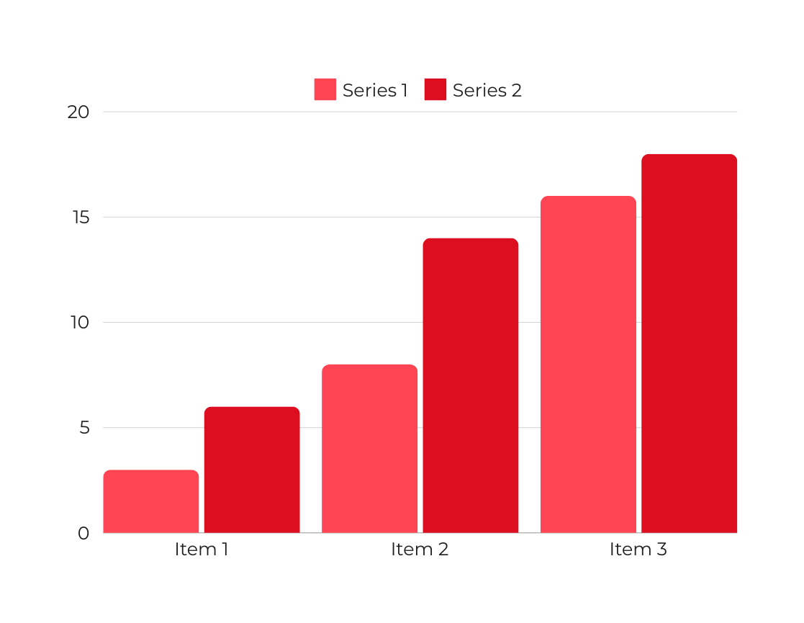
Key Data Features:
01
01
Listing ID: Unique identifier for each property.
02
Host Name: Name of the property owner or manager.
03
Location (Coordinates & Neighborhood): Geographic location of properties.
04
Price per Night: Rental cost per night in GBP.
05
Property Type: Entire home, apartment, or private room.
06
Guest Reviews & Ratings: Number of reviews and average guest ratings.
07
Availability: Number of available days in the next 30 and 365 days.

Slide 4


TYPES OF DATA ANALYSIS
Descriptive, Diagnostic and Predictive
Descriptive Analysis: Summarizes historical data to understand what has happened.
Diagnostic Analysis: Explains why something happened by identifying patterns or relationships.
Predictive Analysis: Uses data to forecast future trends and outcomes based on historical data.

Slide 5
Fady Emil
Maryam Eslam
Aya Ahmed Ali
THE DATA ANALYSIS PROCESS
Data Collection
Transformation and Data Check
Gather Airbnb listing data from Kaggle, including property details, pricing, location, host information, and guest reviews, from the platform or external sources.
Ensure the data is clean by removing duplicates, handling missing values, and correcting data types to maintain accuracy in analysis.
Data Analysis
Interpretation, and Reporting
Analyze key factors like pricing trends, host behavior, and guest satisfaction. Identify patterns based on property type, location, and availability.
Interpret results to understand market dynamics, and create reports to guide pricing strategies, investment decisions, and competitive positioning.

Slide 6

TOOLS USED IN DATA ANALYSIS
Leveraging Technology for Better Insights
Power BI: The primary tool for creating interactive dashboards and visualizing Airbnb data trends. Most visualizations were created directly within Power BI, making it easy to analyze pricing, demand, and location-based insights.

Slide 7
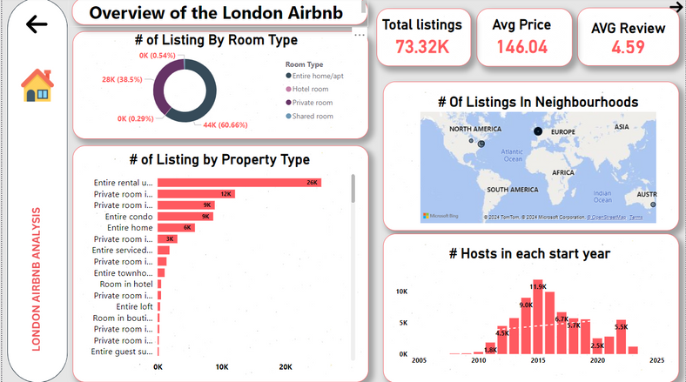
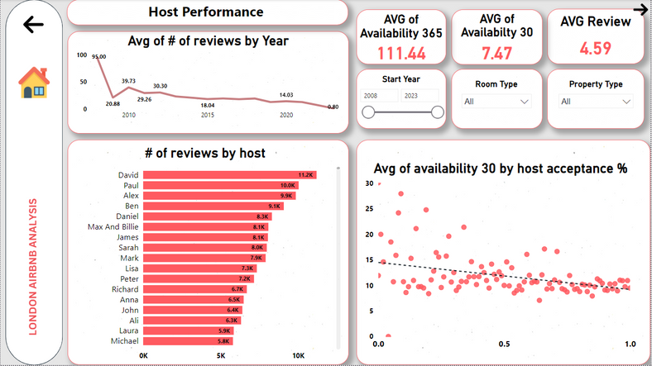
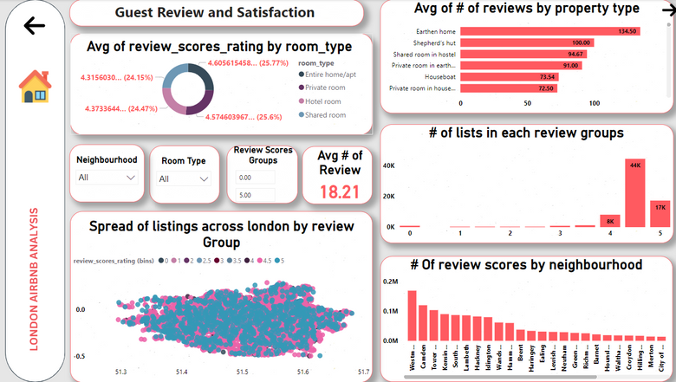
London Airbnb Overview
2. Host Performance
3.Guest Review and Satisfaction
Problem:
Hosts want to compare their performance with competitors and improve based on guest feedback.
Solution:
Provide key host performance metrics, such as:
Review Scores: Track guest ratings to measure satisfaction.
Response Rates: Monitor how quickly hosts respond to bookings.
Availability: Analyze the number of available days to optimize occupancy.
Total Listings: Over 73,000 Airbnb properties listed.
Average Price: £146.04 per night.
Average Review Rating: 4.59 out of 5.
Listings by Room Type: Majority of listings are entire homes/apartments (60.66%) and private rooms (38.5%).
Listings by Property Type: Entire rental units dominate the market with 26K listings.
Hosts Growth: The number of hosts peaked around 2015 with nearly 12K new hosts, with growth slowing in recent years.
Problem:
Hosts need to understand how guest satisfaction impacts bookings.
Solution:
Analyze guest review scores to identify improvement areas like cleanliness and communication. The dashboard shows:
Average review scores by room and property type.
Review distribution across London.
Top neighborhoods by review scores.
This helps hosts focus on improving guest experience to boost future bookings.

Slide 8
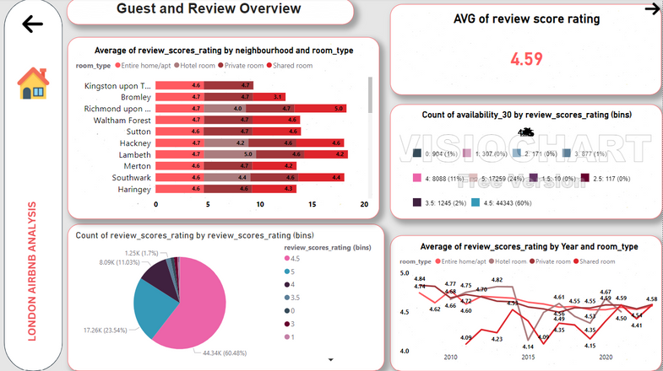
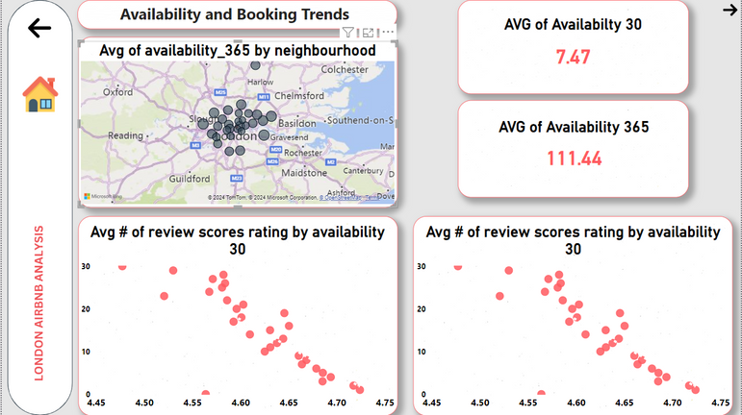
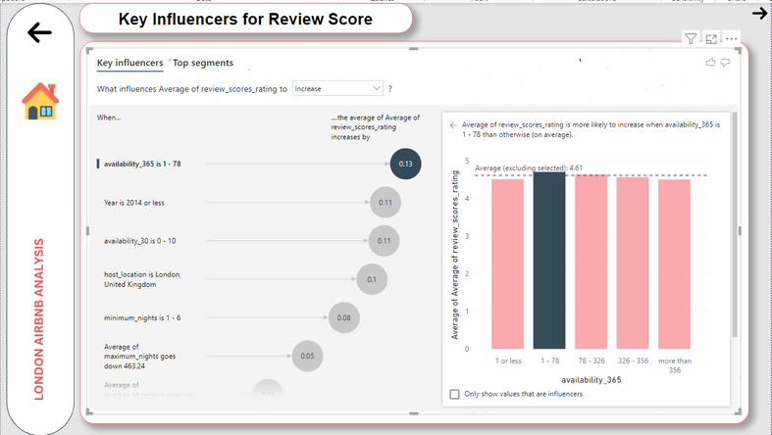
4.Guest and Review Overview
5.Availability and Booking Trends
6.Key Influencers for Review Score
Problem: Hosts struggle to set optimal prices for their properties.
Solution: Provide insights into average price trends and booking patterns based on:
Room Type: Hotel rooms and entire homes/apartments command higher prices. Neighborhood: Westminster has the highest average price (£325), while Barking and Dagenham has the lowest. Property Type: Different property types have varying price points, helping hosts price competitively.
This allows hosts to adjust their pricing strategies based on location and property characteristics to maximize revenue.
Problem:
Hosts need to understand how availability impacts bookings and guest reviews.
Solution:
Analyze booking availability over the next 30 and 365 days and its relationship with guest review scores. The dashboard shows:
Average Availability:
7.47 days (30-day period)
111.44 days (365-day period)
Review Scores vs. Availability: Visualizes how availability correlates with guest review scores, helping hosts optimize their availability for better ratings and increased bookings.
Problem:
Hosts need to know which factors have the most influence on their review scores to improve guest satisfaction.
Solution:
Identify key influencers for higher review scores. The dashboard shows that:
Availability (1-78 days) has the most significant positive impact, increasing the average review score by 0.13.
Older Listings (before 2014) and lower availability (0-10 days) also positively affect review scores.
This analysis helps hosts focus on the most influential factors to boost their ratings.

Slide 9
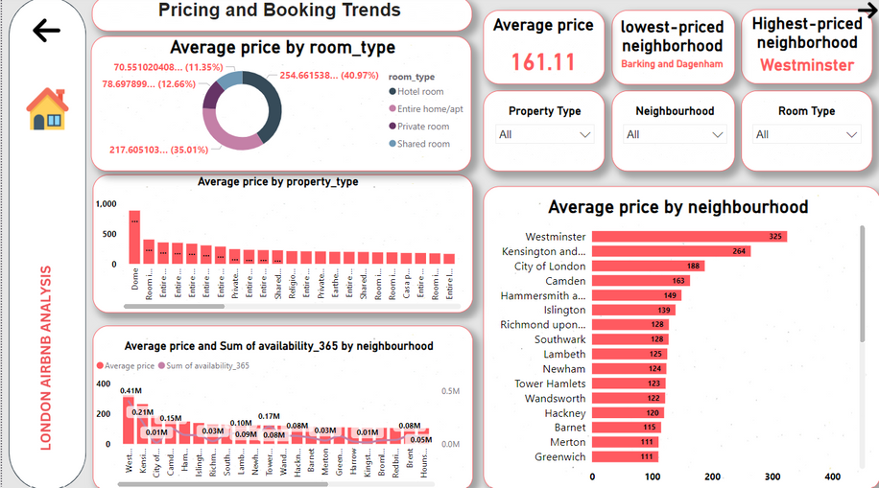
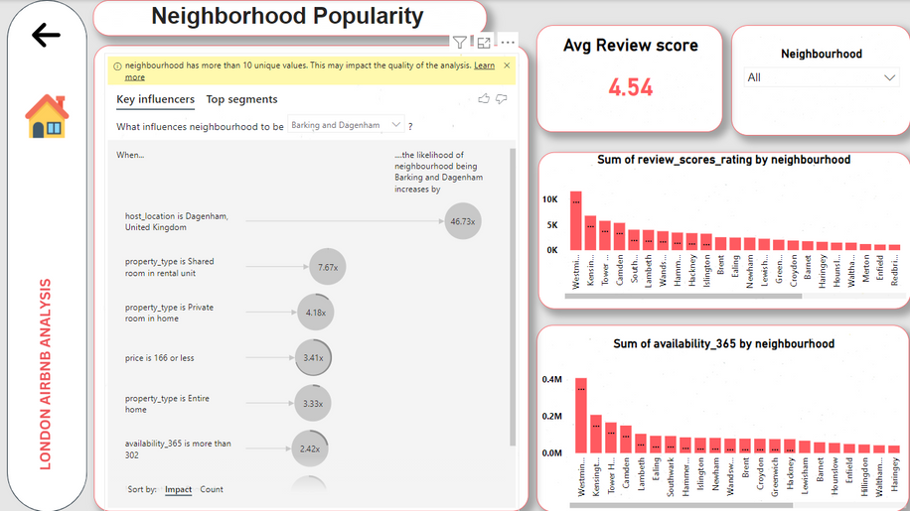
7.Pricing and Booking Trends
8.Neighborhood Popularity
Problem:
Hosts struggle to set optimal prices for their properties.
Solution:
Provide insights into average price trends and booking patterns based on:
Room Type: Hotel rooms and entire homes/apartments command higher prices.
Neighborhood: Westminster has the highest average price (£325), while Barking and Dagenham has the lowest.
Property Type: Different property types have varying price points, helping hosts price competitively.
This allows hosts to adjust their pricing strategies based on location and property characteristics to maximize revenue.
Problem:
Hosts are unsure which neighborhoods attract the most bookings.
Solution:
Analyze the most popular neighborhoods based on:
Booking Volume: Westminster and Kensington lead in terms of booking volume.
Guest Reviews: Neighborhoods like Westminster and Camden have the highest review scores.
Property Availability: Areas with the highest availability include Westminster and Tower Hamlets, helping hosts understand where demand and availability are balanced.
This allows hosts to target popular areas for better booking opportunities.

Slide 10
CONCLUSION & RESULTS
Overview of the London Airbnb Market:
Total Listings: 73.32K properties with an average price of £146.04 and an average review score of 4.59.
Most listings are entire homes (60.66%) and private rooms (38.5%).
Host Performance:
Review count has declined over the years, with top hosts receiving over 10K reviews.
Hosts with lower availability tend to have higher review scores, indicating that booking demand and availability influence guest satisfaction.
Guest Review and Satisfaction:
Review scores remain stable across room types, with private rooms and entire homes scoring higher.
The majority of listings have high review scores, with 60% of properties rated 4.5 or above.
Availability and Booking Trends:
Listings with limited availability (1-78 days) tend to have higher review scores.
Hosts need to balance availability with demand to optimize ratings and bookings.
Key Influencers for Review Scores:
High review scores are influenced by low availability, older properties, and prime locations like London.
Pricing and Booking Trends:
The average price is £161.11, with Westminster being the most expensive neighborhood (£325).
Entire homes and hotel rooms have the highest average prices.
Guest and Review Overview:
Certain neighborhoods like Lambeth and Bromley consistently receive high review scores.
Entire homes and hotel rooms tend to receive better reviews compared to other property types.
Neighborhood Popularity:
Westminster and Kensington are the most popular neighborhoods based on bookings, reviews, and availability.
Property types like shared rooms and private rooms are more common in neighborhoods like Barking and Dagenham.

Slide 11

Fady Emil
Maryam Eslam
Aya Ahmed Ali
See You Next
THANK YOU
Airbnb Analytics Squad
Implementing company: ACIST
DR. Mohamed Anwar

